Slide 1
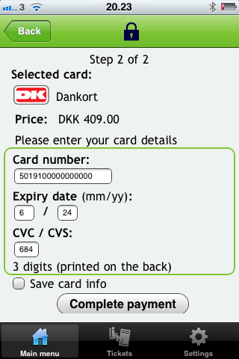
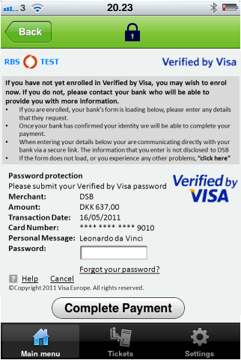
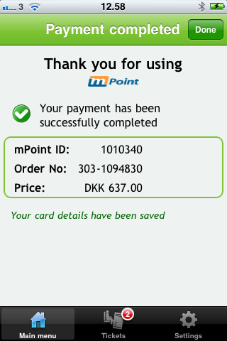
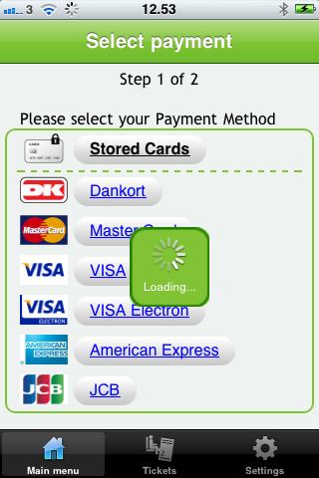
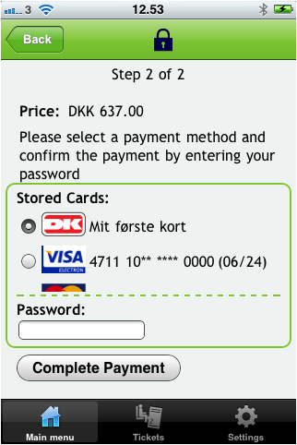
Non-Optimized 3D SEcure
Optimized input fields
Intuitive storage of cards
Enter card details
3D Secure auth
Payment completed
Select payment method
User defined card names
Seamless support for 3D Secure
Authorise payment

Slide 2
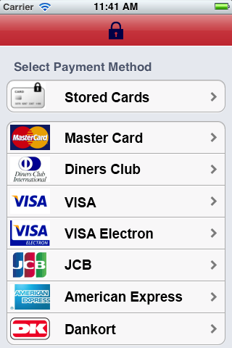
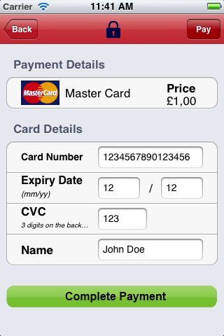
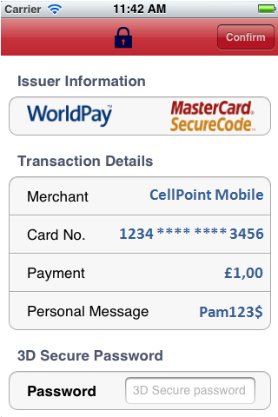
Mobile Optimized 3D SEcure
Select payment method
Enter card details
3D Secure auth

Slide 3
Payment options
Payment Solution | Setup | License | Transaction
WorldPay | X | X | X
Other PSP | X | X | X
Standalone | X | X
What are the benefits of Verified by Visa, MasterCard SecureCode and JCB J/Secure programs for YOU?
When you process transactions using Click2Sell 3-D Secure feature, you will be 95%+ protected from the chargebacks.
You are not liable for chargebacks that result from fraudulent unauthorized use of Visa, Mastercard or JCB cards.
Fraud on your website is reduced since 3-D Secure protection saves you from unauthorized card use
Even if chargeback comes later, you are no liable for it and you don’t pay a cent to your vendor account’s bank. No more $20-$30 bills everytime you receive a chargeback.
Visa, MasterCard and JCB protects you in case of chargebacks
Your customers enjoy a safer place to shop when they see Verified by Visa, MasterCard SecureCode and JCB J/Secure logos on your product’s checkout pages
The transaction costs are reduced at least 0.5%, up to 2%! You can qualify for a lower transaction fees for your e-commerce transactions if you use 3-D Secure protection. So if you are paying 2% or 4% fee for your vendor account provider, you can easily reduce this cost up to 2%. This can save you thousands of dollars every month!
When you participate in these 3-D Secure programs your customers and their transactions are safe.
Expand the geographic reach of your business by selling to customers outside your country without worrying about possible fraud.
Advertise your website for free and attract customers on the Visa and MasterCard consumer websites.
http://www.click2sell.eu/en/3d-secure.html

